Slide 1

Dr. Alisha Ali
alisha.ali@nyu.edu
Dr. June Ahn
june.ahn@uci.edu
Dr. Bruce Homer
bhomer@gc.cuny.edu
Lilo
A research project of the ACTS Lab (NYU), the Design & Partnership Lab (UC Irvine) and CUNY
lilobot.io

Slide 2
Lilo is an app built to address Summer Melt
In our research with NYC High Schools: 25-80% of low-income NYC students who are admitted to college, do not enroll.
(data from NYC College Advising Corps)
These melt rates are double national averages of 8-40%. (Castleman & Page, 2014¹)

Slide 3
Lilo is designed to reduce rates of summer melt and increase enrollment yield for colleges.
The app is designed to provide:
(1) informational support and reminders, and
(2) important socio-emotional conversations with trained mentors.

Slide 4
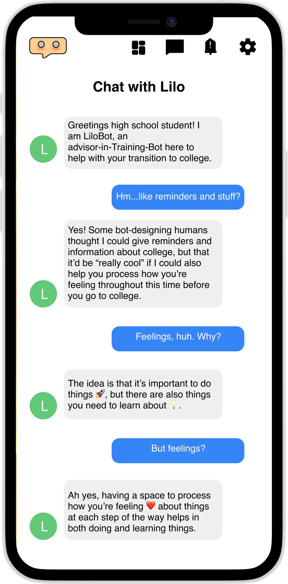
Lilo is an interactive chatbot assistant to help pre-matriculated students navigate the college enrollment process between April and August.

Slide 5
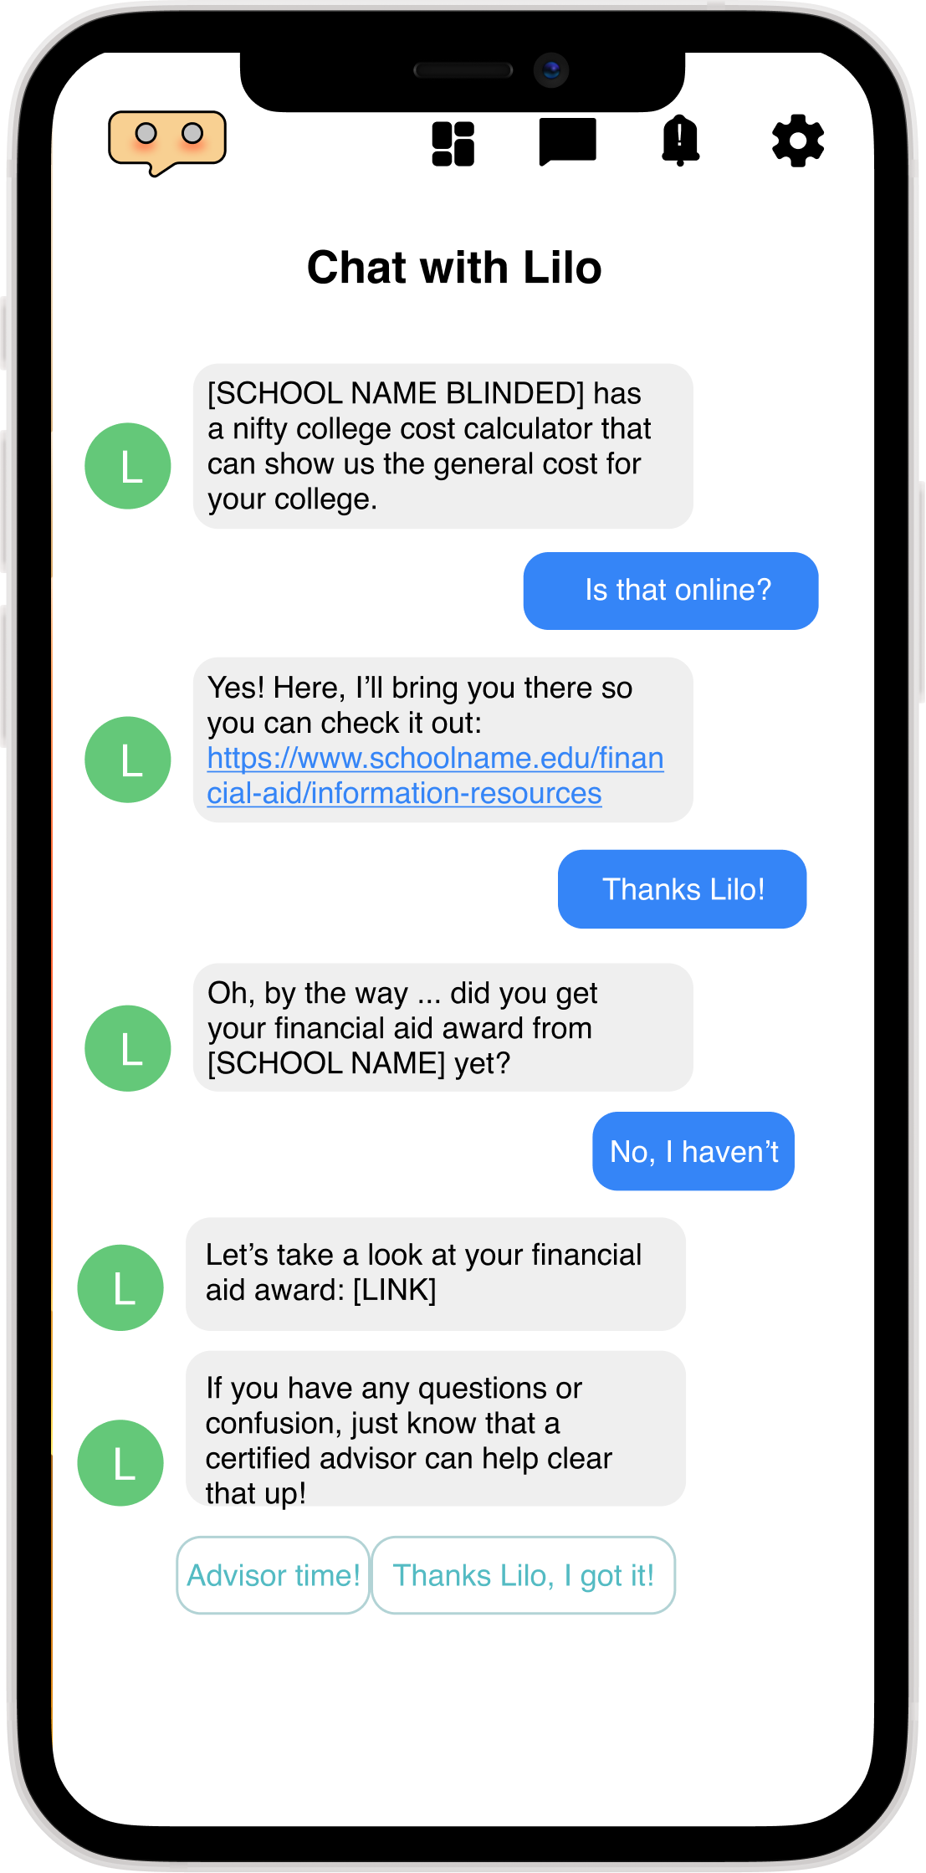
Lilo sends reminders/nudges to help accepted students keep track of enrollment tasks.

Slide 6
Lilo adds two key, unique features:
Using AI to answer students’ frequently asked questions
Linking students to human mentors who are on call to have deeper conversations

Slide 7
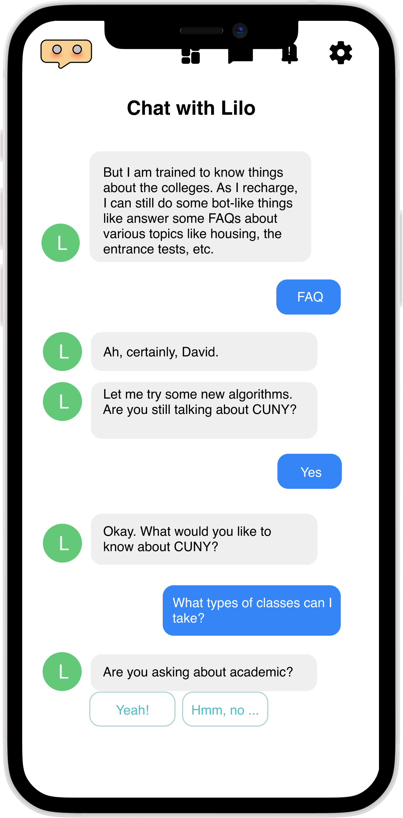
Lilo uses machine learning to train itself with information about each college.
Students can text questions to Lilo and get answers to commonly asked questions.

Slide 8
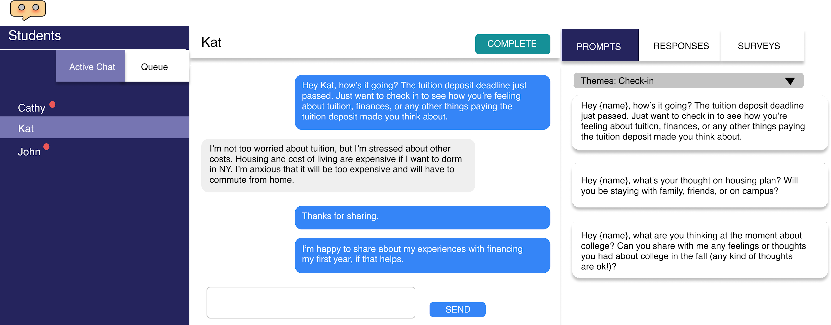
In Lilo: Human mentors are also on call to provide socio-emotional conversations

Slide 9
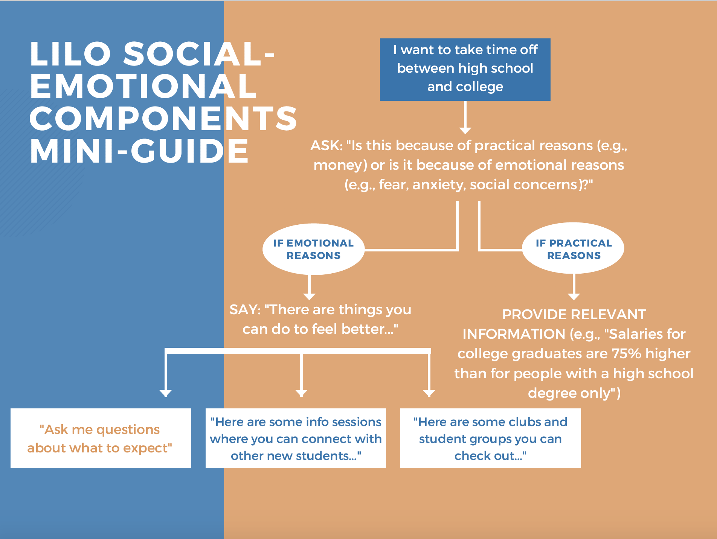
Mentor Interactions
The mentors are provided with flowcharts and written prompts to guide the content of the text messages they send to the college-bound students.
The mentors lists of resources to provide to students who may be in distress.
Example of flowchart guide that the mentors utilize

Slide 10
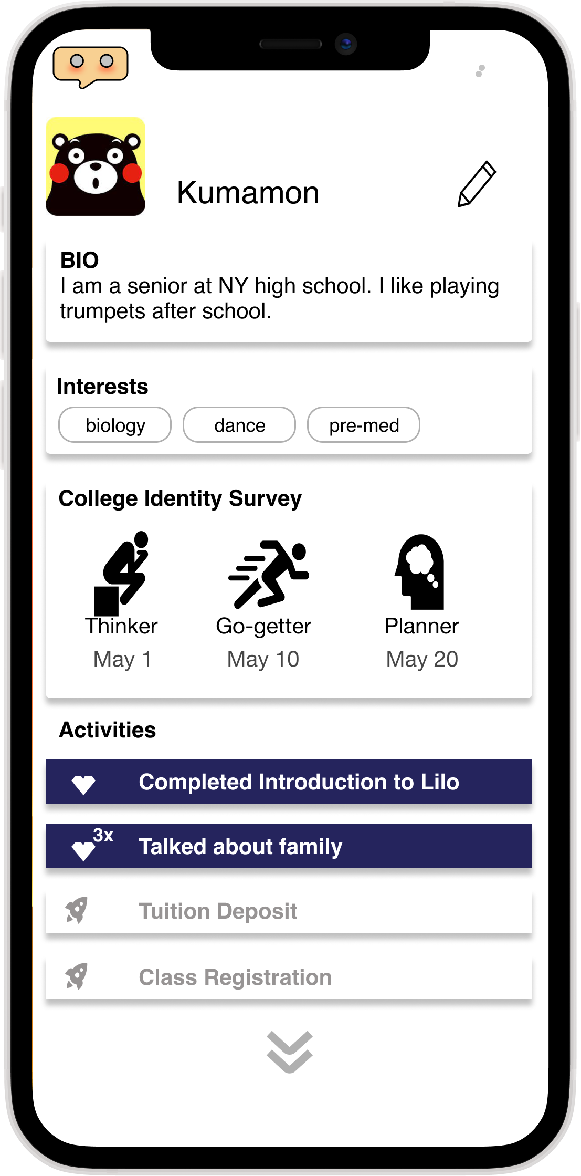
Lilo visually tracks students’ progress toward enrollment.

Slide 11
Spring of 2022…
Mentors will be trained to provide support to students anonymously by text (you will choose a pseudonym).
We want to be ready to start texting with the students shortly after they received their acceptance notifications from CUNY.

